Slide 1
Elbi of America
COMPANY PROFILE
Founded in 1990, Elbi of America, Inc. is an innovative manufacturing company, backed by the extensive experience of our parent company, Elbi S.p.A..
Our Houston manufacturing facility is fully developed and meets the strong demand for our domestically produced products.
We can approach both small and large volume customers with great confidence since we can offer them quality products which meet all industry standards and which proved to exceed our existing customer's expectation. Furthermore, we can offer a wide variety of products characterized by quality, reliability, an elegant design and finishing and backed by on time deliveries and strong customer service support.
These factors combined with our highly competitive pricing, create a winning formula which has set our products in a league of its own.
Over 30 years in tank building.

Slide 2
Elbi SpA Italy-Corporate
Located in Limena Italy SW of Venice

Slide 3
Shell Roller

Slide 4
Raw Steel Coils

Slide 5
Automated Head Welding

Slide 6
Coupling Welding

Slide 7
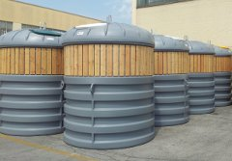
Product Diversity
TWENTYFIRST GARDEN ART
21st Garden Art offers a wide selection of pots for plants and flowers in rotational polyethylene (Terra, Fiore and Nude Collections), and proposes a new collection dedicated to the kennels for dogs and cats characterized by the modern and innovative design (Pet Collection).
TWENTYFIRST LIVING ART
21st Living Art represents a set of landing stages that have been discovered and marked on new artistic maps. This collection gives our senses a new dimension of perception.
ENVIRONMENT
The Environment Division operates mainly in the field of design, manufacture and marketing of containers and bells for selective collection of waste, and a wide range of accessories for urban hygiene and decor.

Slide 8
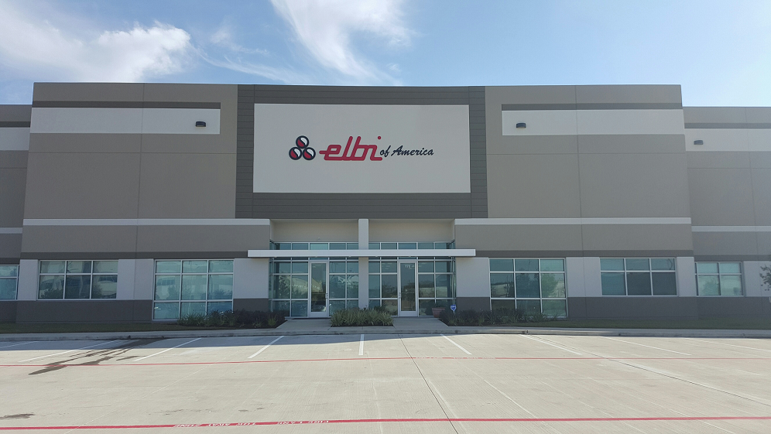
Elbi Houston Facility
15882 Diplomatic Plaza Suite 170 Houston, TX 77032
40 thousand square feet warehouse & office

Slide 9
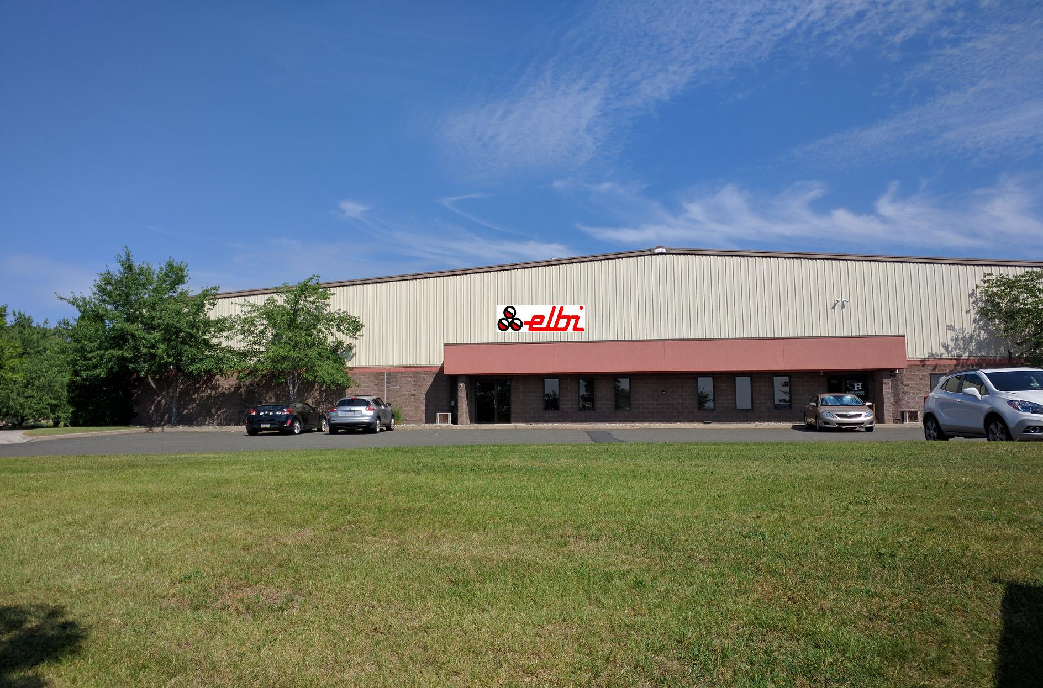
Elbi Northeast Facility
41 Robinson Street, Pottstown PA 19464
20 thousand square feet warehouse & office

Slide 10
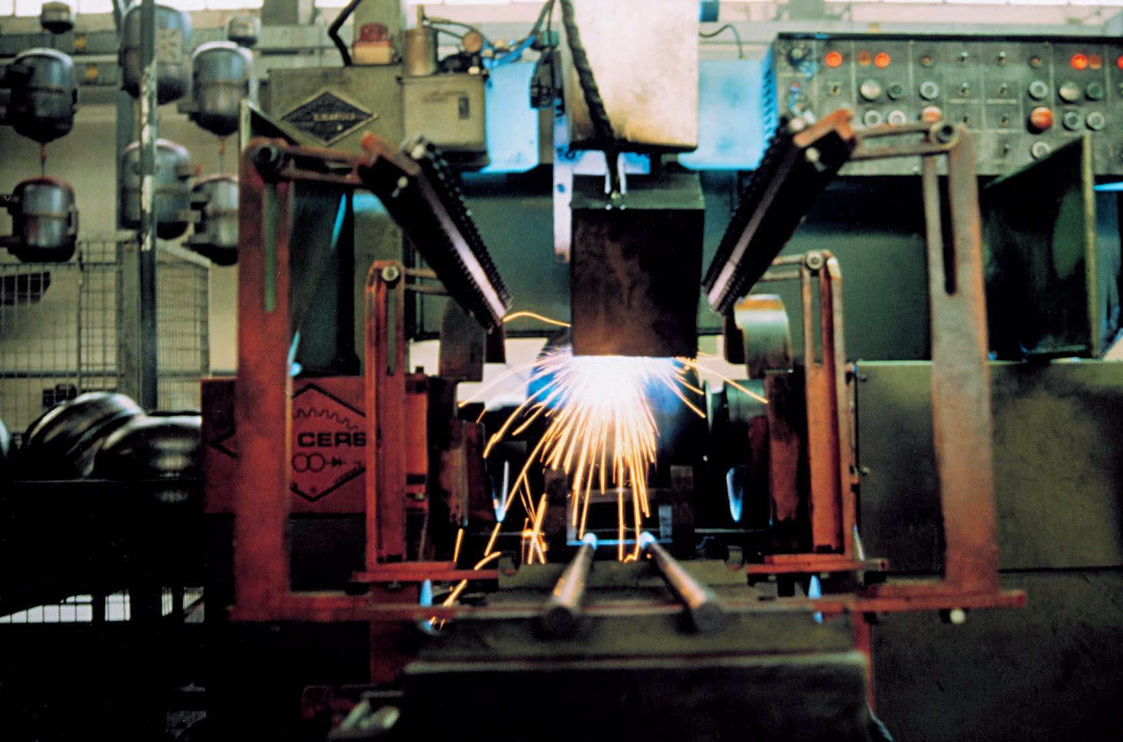
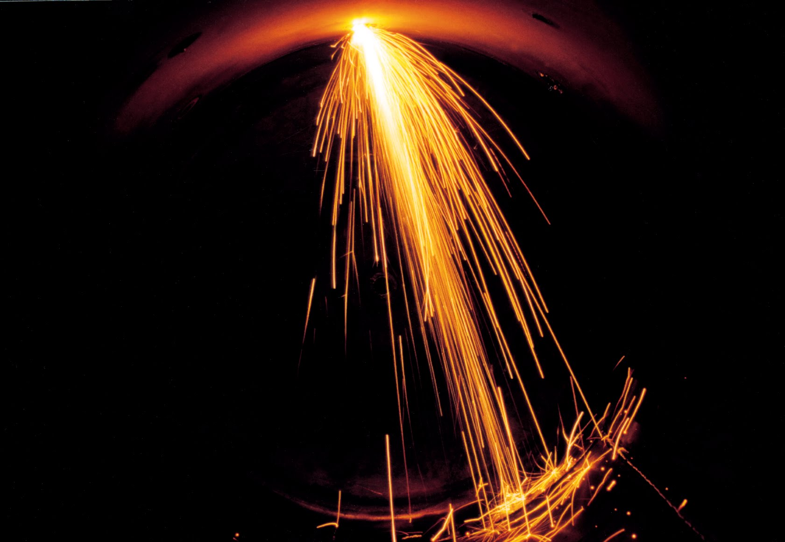
Capabilities

Slide 11
Residential Products
Residential Products:
Diaphragm Expansion Tanks
Diaphragm Thermal Expansion Tanks
Diaphragm Well Water Tanks

Slide 12
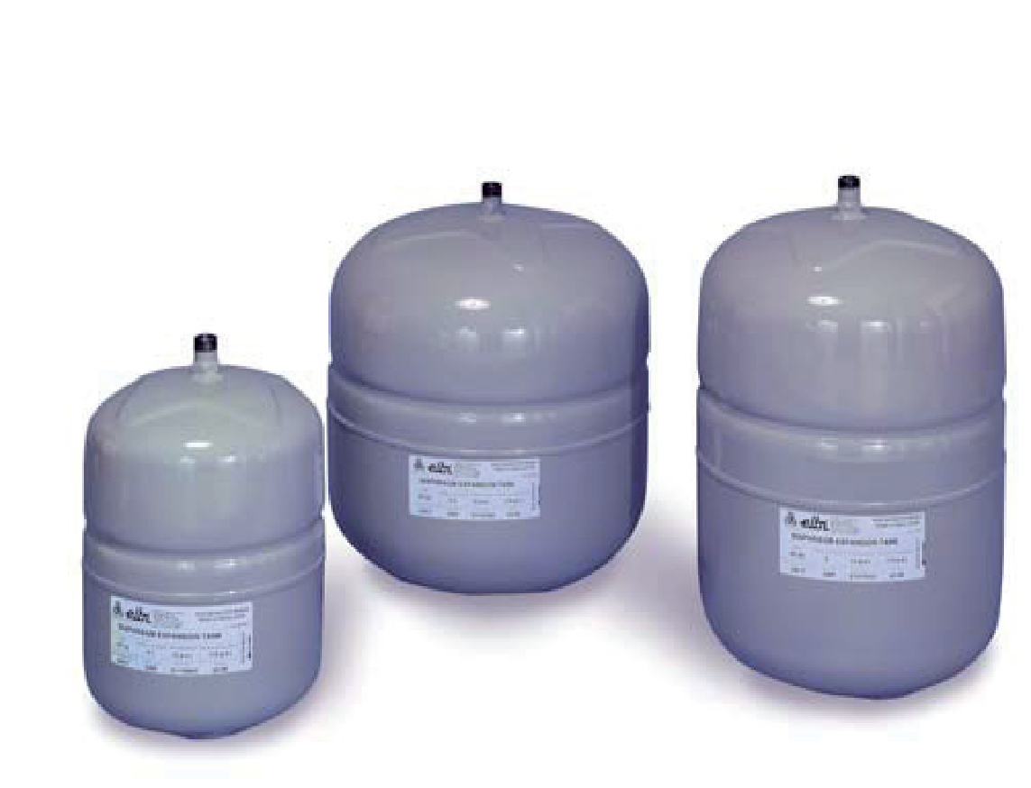
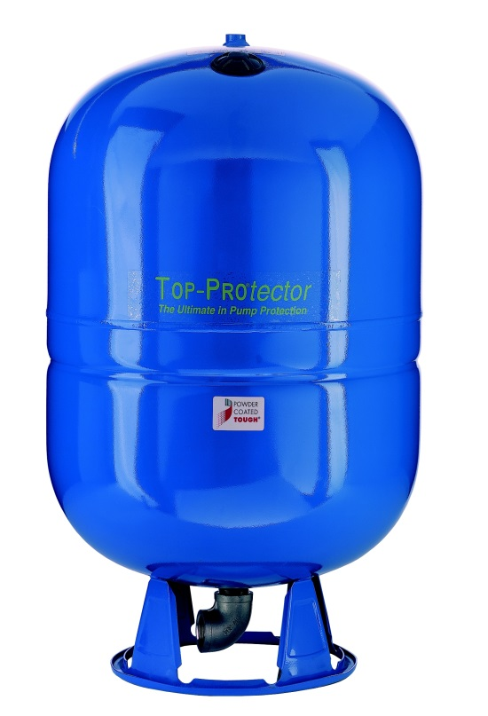
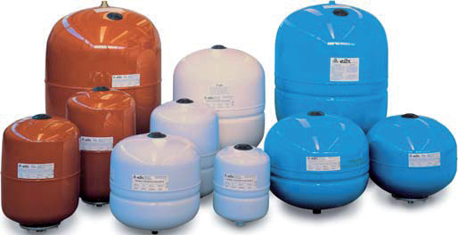
Residential Products
Elbi XT/XTV-Series Expansion Tanks
Elbi DWT-Series well Tanks
Elbi DXT-Series Thermal Tanks

Slide 13
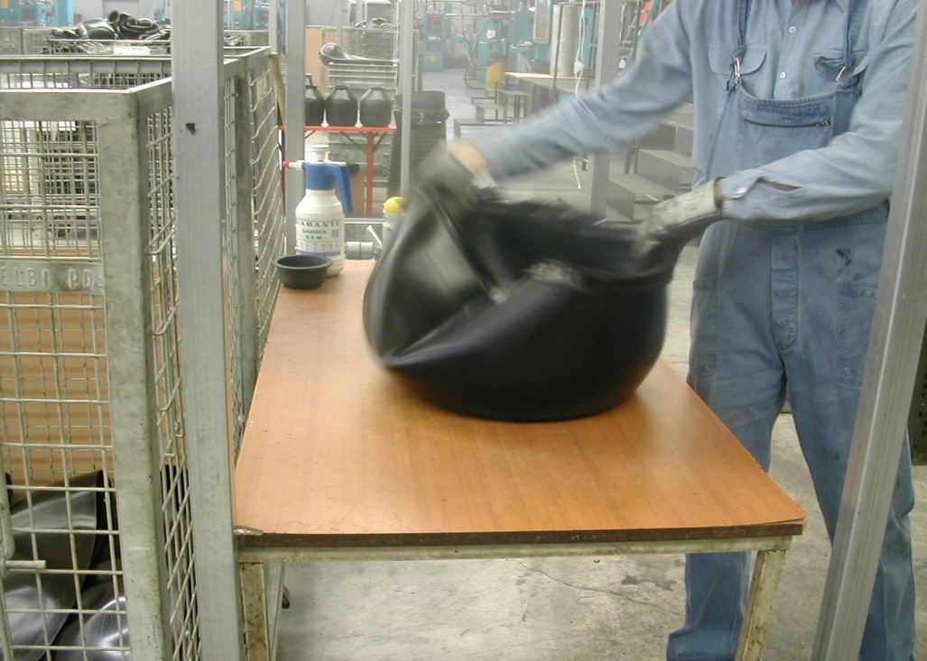
Diaphragms Manufacturing

Slide 14
ASME Commercial Products
Hi Capacity Air vents
ASME Air Separators
ASME Domestic Bladder Tanks
ASME Hydronic Heating Bladder Tanks
ASME Domestic Heating Tanks
ASME Chill Water Tanks
PLAIN Steel expansion tanks
ASME Flash Tanks
ASME Epoxy Lined Storage Tanks
ASME/Non-Code Glasslined Insulated tanks
ASME Chill Water Tanks
Cast iron Triple Duty Valves
Cast iron Suction Diffusers
ASME 200 PSI Booster Bladder Tanks
Custom Tanks

Slide 15
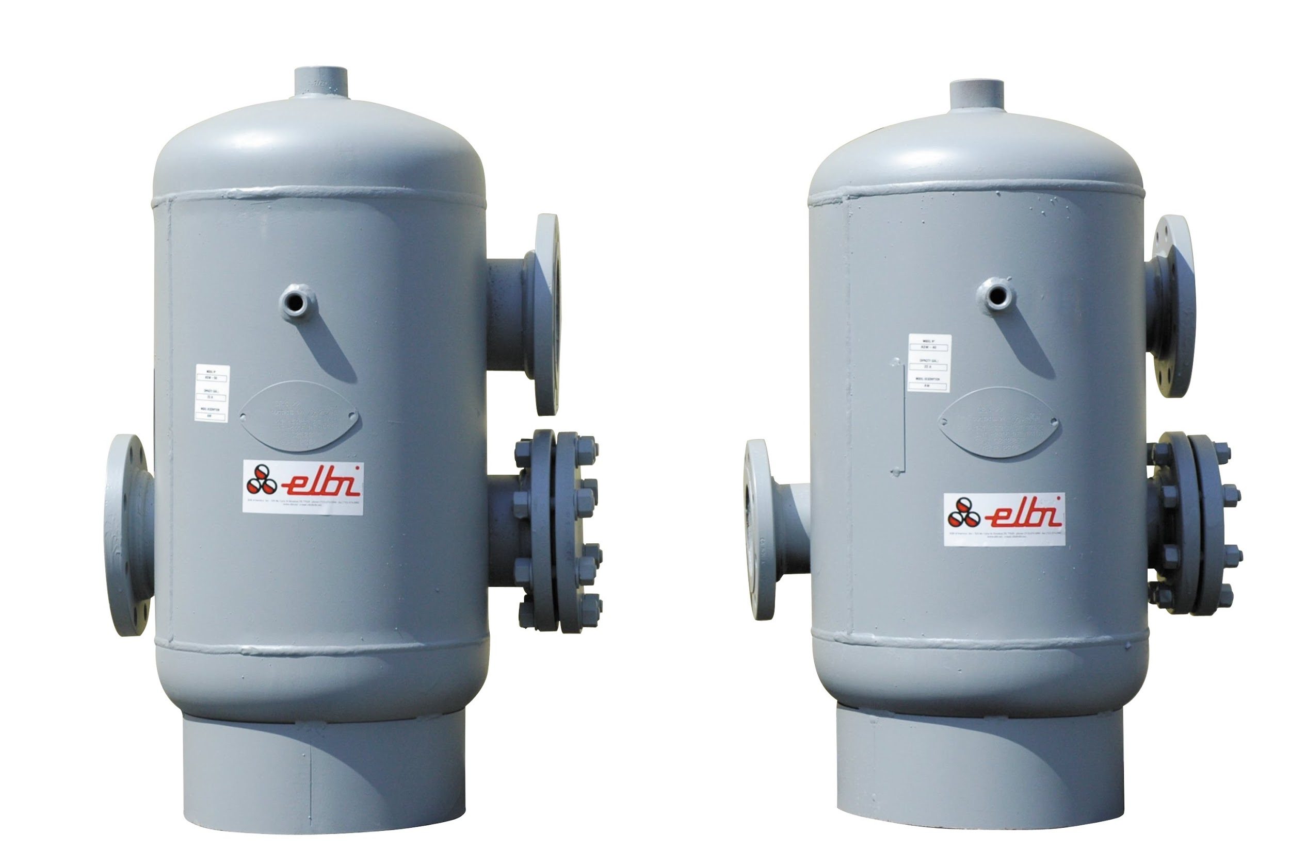
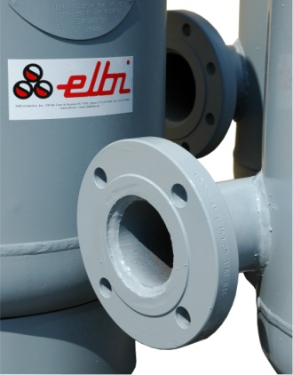
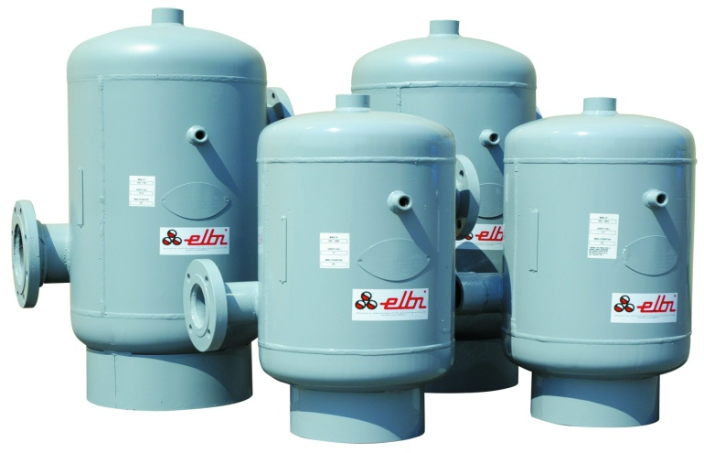
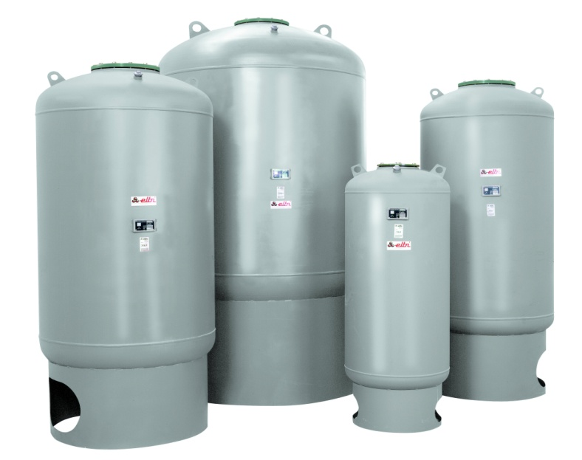
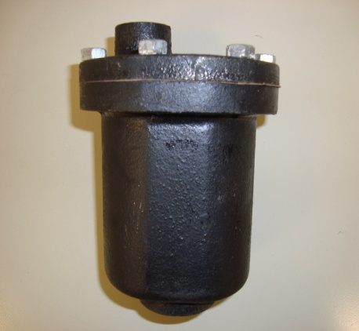
Commercial Products
STOCK 200 PSI Booster Tanks

Slide 16
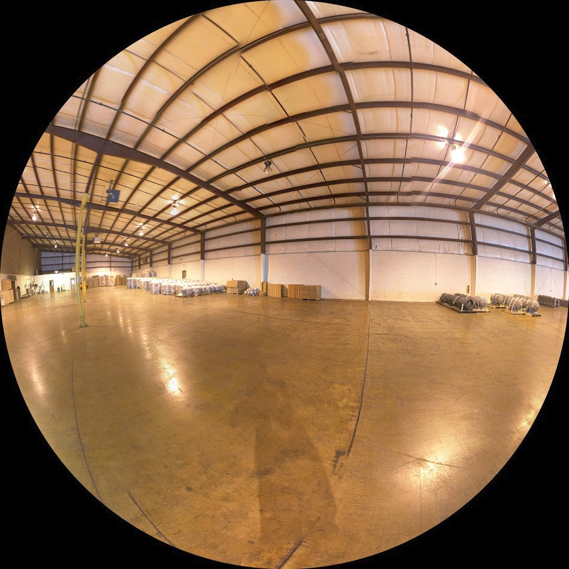
ELBI of America NE Warehouse

Slide 17
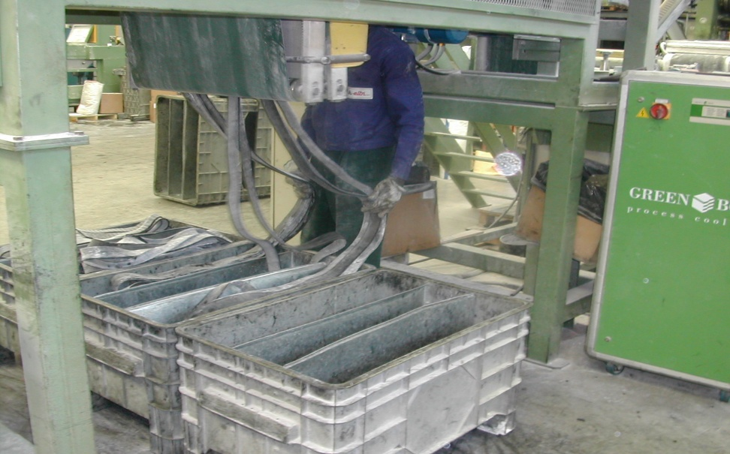
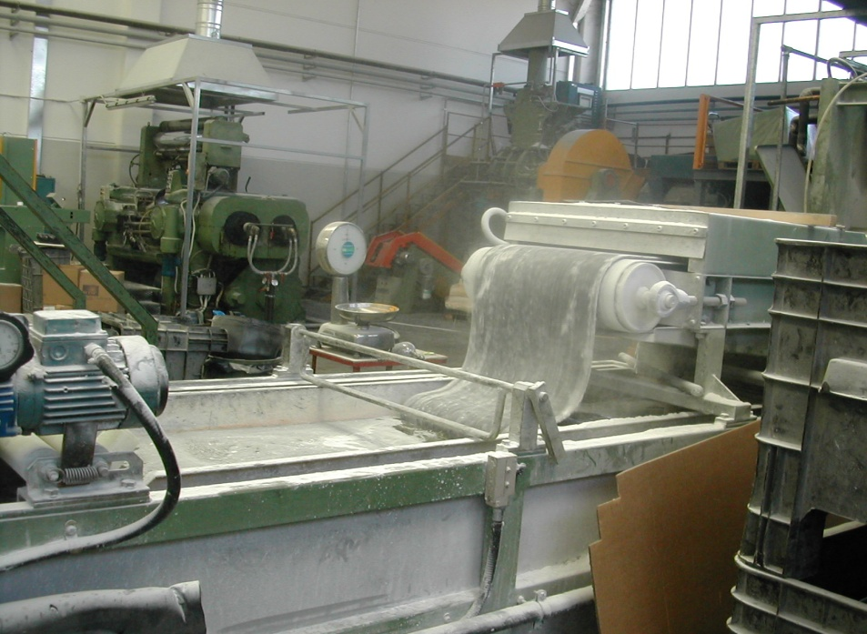
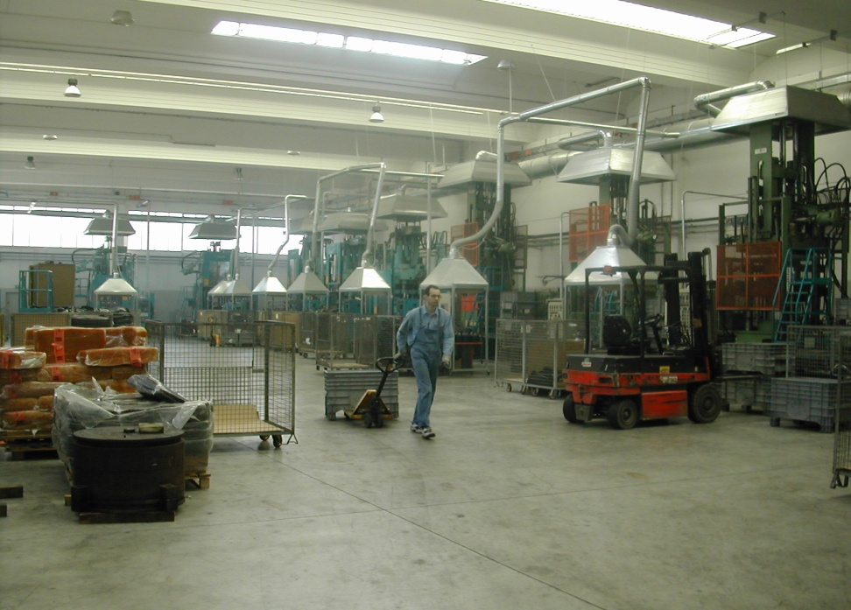
Bladder Production

Slide 18
Full Volume Bladder Extrusion

Slide 19
ASME Bladder Tank Cut-out

Slide 20
Burning Table

Slide 21
Burning Holes

Slide 22
Sub-Arc Welder

Slide 23
Texas Air Product CW Tank

Slide 24
TAP Internal Baffle

Slide 25
Texas Air Product CW Internal Baffle

Slide 26
Texas Air Product Chill Water Tank

Slide 27
Tank for Water Tanker Truck

Slide 28
316 Stainless Steel Vacuum Chamber

Slide 29
State Hospital California
3000 Liter Domestic Bag Tanks

Slide 30
A SERVICE DRIVEN COMPANY

Slide 31
ELBI’S CUSTOMER COMMITMENTS
Elbi’s no hassle rapid response.
Live person to answer your request.
Most products will ship within 24 hours.
Volume allows Elbi to secure the best LTL freight rates for our customers.
Shipments are verified by e-mail from Elbi with tracking #.

